Slide 1

SESHADRI RAO GUDLAVALLERU ENGINEERING COLLEGE (An Autonomous Institute with Permanent Affiliation to JNTUK, Kakinada)
Smart Vision-Based Attendance System Using IoT and ML with Real-Time Notifications
Batch No:12
Presented By:
Sowmya Sri.G (22481A60A2)
M.Mohammad Abbas (22481A6068)
T.Srikanth (22481A60A4)
M.Bhaviya Sri (23485A6014)
Under the Guidance of
Mr. Shaik Bajivali
Assistant Professor of IoT
DEPARTMENT OF INTERNET OF THINGS
Seshadri Rao Knowledge Village, Gudlavalleru 521356

Slide 2
CONTENTS
Motivation
Objectives
Introduction
Literature Survey
Title of Smart Attendance using RFID and Face Recognition
Title of Smart Vision-Based Attendance System Using IoT and ML With Real Time Notifications
Design Methodology
Block Diagram of Title of Proposed Project
Software Tools and Hardware components required
Hardware Implementation
Results&Discussions
Comparison Table of Existing and Proposed System
Conclusion
References
Execution Video
Date:25-02-2026

Slide 3
MOTIVATION
In many schools and colleges, attendance is still taken manually, which takes time and reduces valuable teaching time. It is also easy for students to give proxy attendance for their friends. This project is motivated by the need to replace this old method with an intelligent automated system. By using IoT and machine learning to recognize faces instantly, the system makes attendance faster and more accurate.
Date:25-02-2026
1

Slide 4
OBJECTIVES
This project aims to automate attendance using IoT and machine learning to reduce manual work. It captures and updates attendance in real time through connected devices. The system also sends instant notifications to parents to keep them informed about their child’s attendance. Overall, it saves time for faculty and students and makes attendance management simple and efficient.
Date:25-02-2026
2

Slide 5
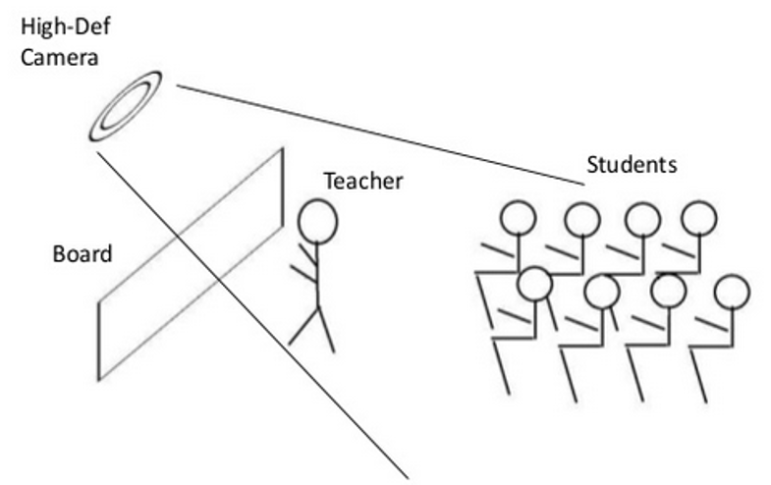
INTRODUCTION
Smart Vision-Based Attendance System is used to automate daily attendance in schools, colleges, and workplaces.
Uses IoT, cameras and ML for real-time attendance.
Sends alert notifications to parents.
Keeps data secure, saves time and easy to use.
Figure 1: Smart Attendance Using IoT and ML
Date:25-02-2026
3

Slide 6
LITERATURE SURVEY
S.No. | Author(s) & Year | Title of the Paper | Methodology | Advantages | Disadvantages
1. | Preetham B R, Prajwal R & Sanjay K (2023) | Smart Attendance Using RFID and Face Recognition | RFID card scanning followed by face recognition verification; attendance stored in centralized database. | Dual authentication improves security; reduces proxy attendance; automated record keeping. | High installation cost; complex setup; system slows if one module fails.
2. | N. Thaleeparambil, A. Biju & B. Prathap(2024) | Integrated RFID-WiFi-Vision Attendance System | RFID identification combined with Wi-Fi data transmission and vision-based verification; cloud storage used. | Multi-layer authentication; remote monitoring; improved reliability. | Expensive setup; requires strong Wi-Fi; higher maintenance complexity.
3. | D. V. Darshan et al.(2024) | IoT-Based Attendance Monitoring with Facial Recognition | Face captured via camera; facial recognition algorithm identifies students; IoT module uploads data to cloud. | Real-time monitoring; automated reports; reduced paperwork. | Performance affected by lighting and occlusion; internet dependency.
4. | A. Raj et al. (2024) | Facial Recognition-Based Student Attendance System | Deep learning-based face detection and recognition; automatic attendance marking using stored database. | Contactless system; high accuracy; prevents proxy attendance. | Requires high processing power; privacy concerns; large dataset needed.
5. | G. Ramani et al. (2023) | Smart Attendance System Using IoT | IoT sensors detect student presence; attendance data transmitted to server and stored automatically. | Low manual effort; simple automation; cloud-based storage. | Cannot prevent proxy attendance; lacks ML verification; basic functionality only.
4

Slide 7
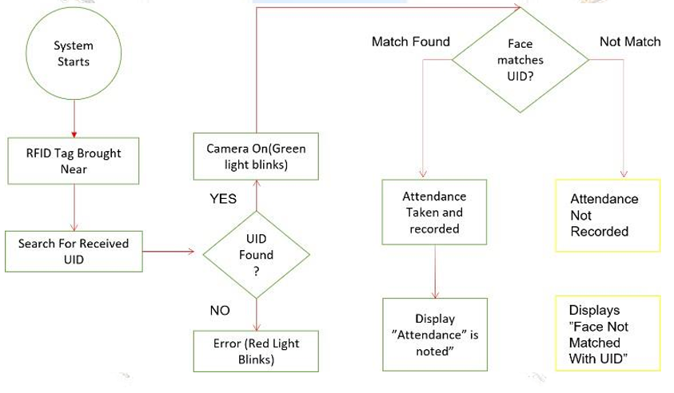
Smart Attendance using RFID and Face Recognition
In existing systems, the process starts when an RFID card is scanned and the UID is checked in the database.
If the face matches the UID, attendance is recorded,if not, it is rejected.
The system depends on RFID cards, which can be lost or misused and the two-step verification process increases time and complexity in large classrooms.
Figure 2 : FlowChart of the Existing System
Date:25-02-2026
5

Slide 8
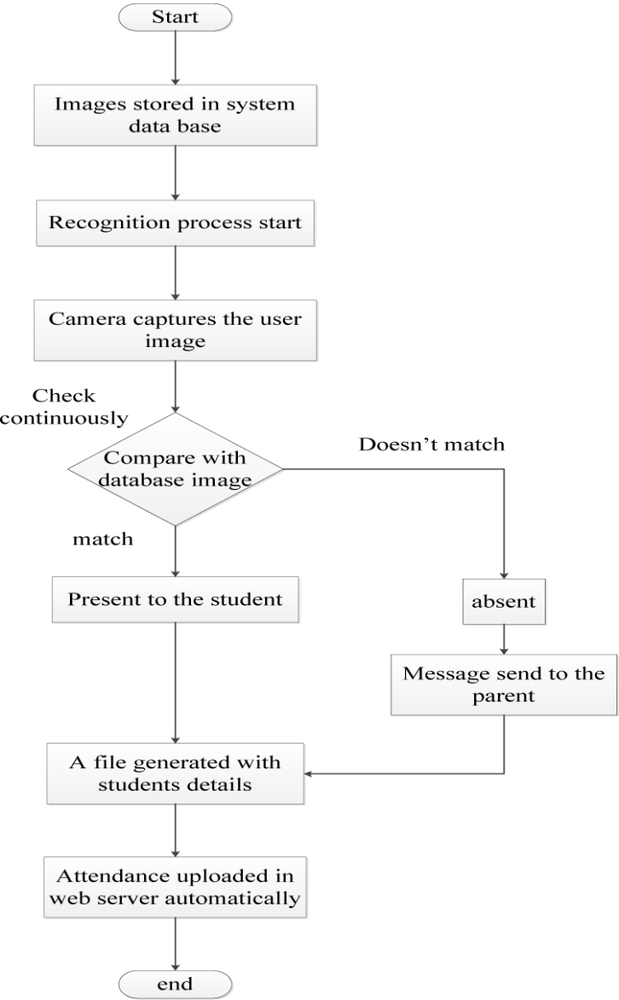
Smart Vision-Based Attendance System Using IOT and ML With Real Time Notifications
In the proposed system, student images are stored in the database and the camera automatically captures faces for recognition.
If the face matches the database, attendance is recorded instantly, if not, the student is marked absent and a notification is sent to parents.
The system can recognize multiple students at the same time in a single frame, which saves time and works well in large classrooms.
Date:25-02-2026
6
Figure 3: Flow Chart of Smart Vision Based Attendance System

Slide 9
DESIGN METHODOLOGY OF SMART VISION BASED ATTENDANCE SYSTEM
Image Acquisition
IoT cameras capture student images and send them to an ML model for real-time face recognition.
Verified identities are time-stamped and stored in a secure attendance database.
Parents receive instant SMS notifications when a student is marked absent.
Faculty access an encrypted dashboard to view reports and manage student records.
Real Time Face Recognition
Attendance Verification &Storage
Notification Alerts
Faculty Dashboard Access
Date:25-02-2026
Figure 4: Design Methodology of Smart Vision BasedAttendance System
7

Slide 10
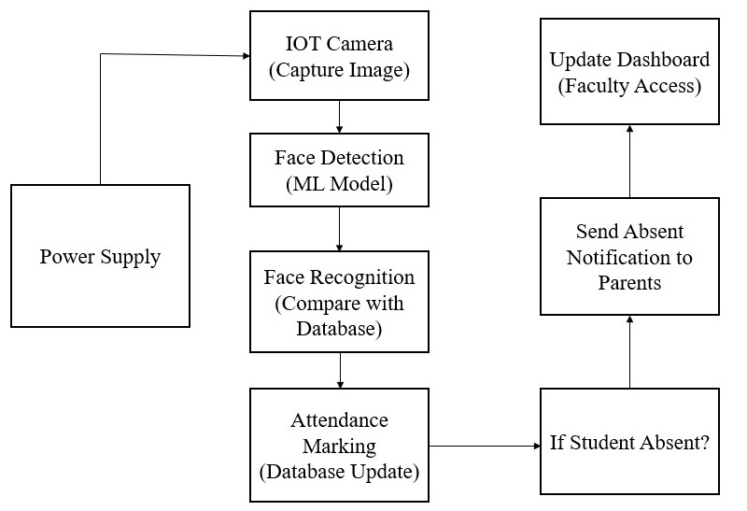
Block Diagram of Smart Vision Based Attendance System Using IoT and ML With Real Time Notifications
Date:25-02-2026
Figure 5: Block Diagram of Proposed System
8

Slide 11
SOFTWARE TOOLS
S.No. | Tools used | Usage | Specifications
1. | Raspberry pi OS | Runs the attendance system and manages hardware operations. | ARM support, Python compatible.
2. | Python | Develops face recognition and attendance processing logic. | Python 3.8, supports ML & IoT libraries.
3. | OpenCV | Performs real-time face detection and image processing from video input. | OpenCV 4.5 with LBPH face recognition support.
4. | Libraries | Supports ML model, data handling. | NumPy, Pandas.
Date:25-02-2026
9

Slide 12
HARDWARE COMPONENTS
S.No. | Components used | Usage | Specifications
1. | Raspberry pi OS | Acts as the main controller for the system.. | Quad-core1.5GHzprocessor, 4GB RAM, Wi-Fi, USB & GPIO support.
2. | SD card | Stores OS, ML model, program code and attendance data. | 64GB, Class 10, high-speed read/write support.
3. | Camera | Captures student faces for real-time recognition. | 1080p resolution, 30 FPS, USB interface.
4. | GSM Module | Sends real-time SMS attendance notifications to parents | SIM800, quad-band GSM
5. | LCD Display | Displays student name and attendance status. | 16x2 LCD, I2C interface
6. | Buzzer | Provides an audio alert when the class ends. | 5V active buzzer
Date:25-02-2026
10

Slide 13
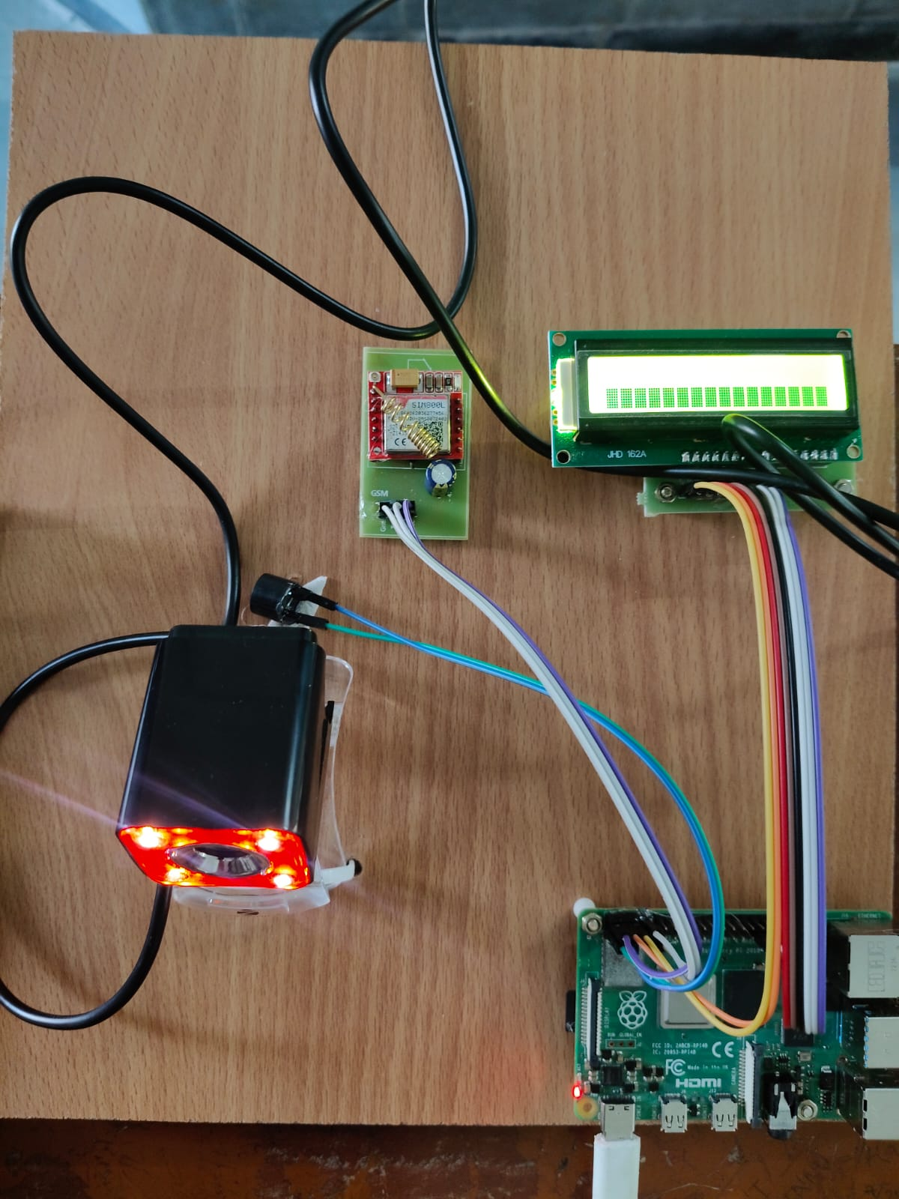
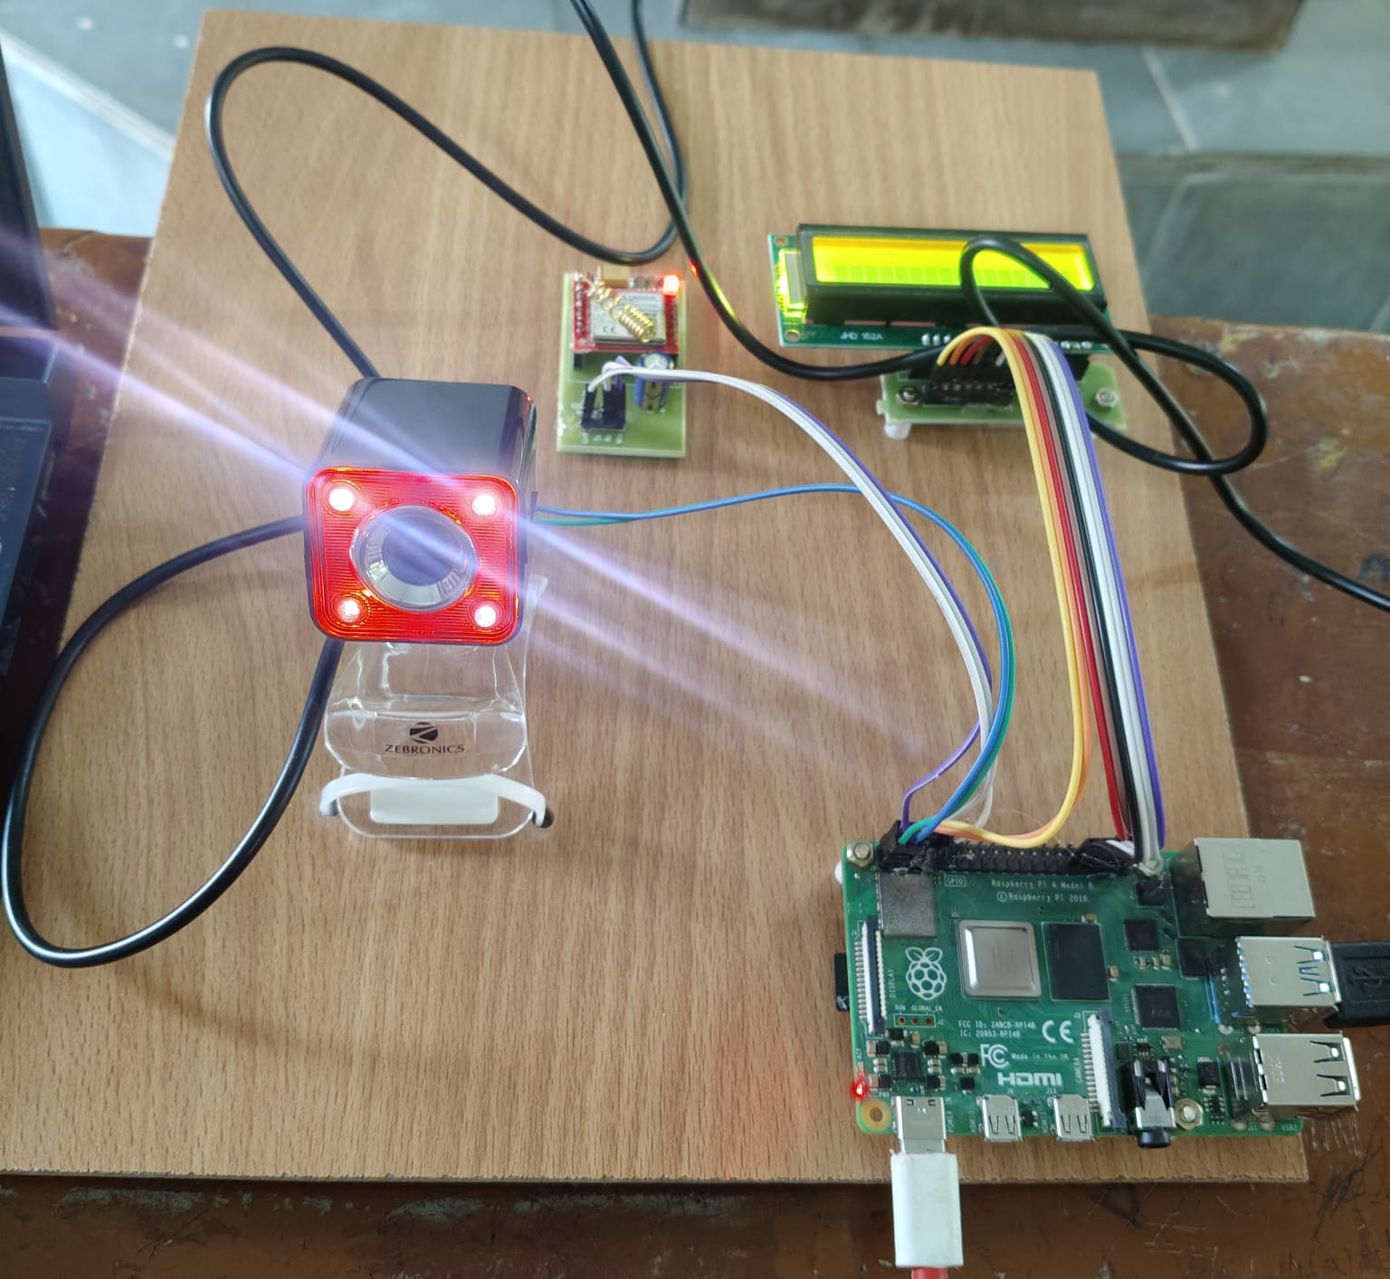
HARDWARE IMPLEMENTATION
Figure 6: Hardware Implementation of the Smart Vision Based Attendance System
Date:25-02-2026
11

Slide 14
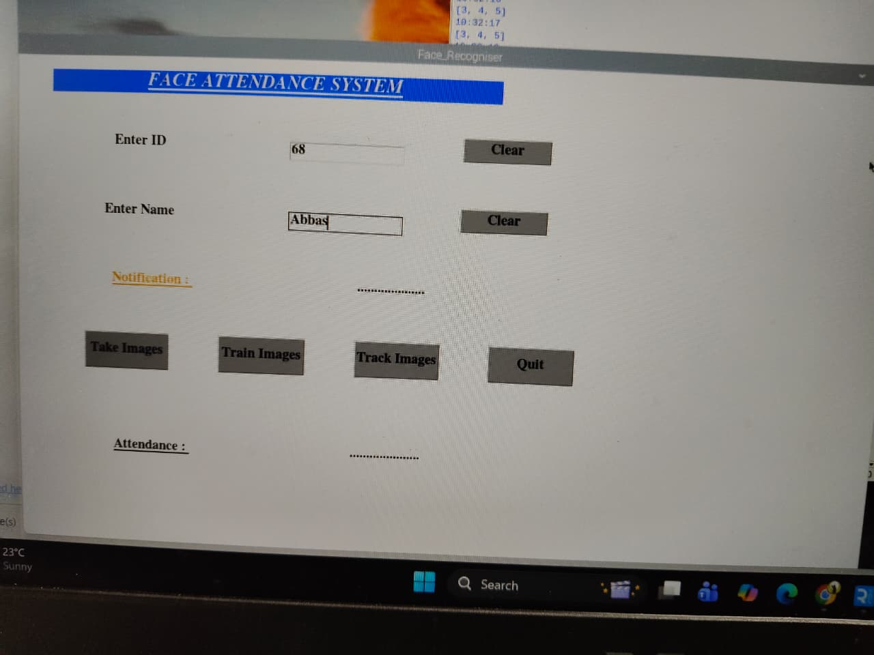
SOFTWARE INTERFACING
Figure 7: Front End Interface of the Attendance System
Date:25-02-2026
12

Slide 15
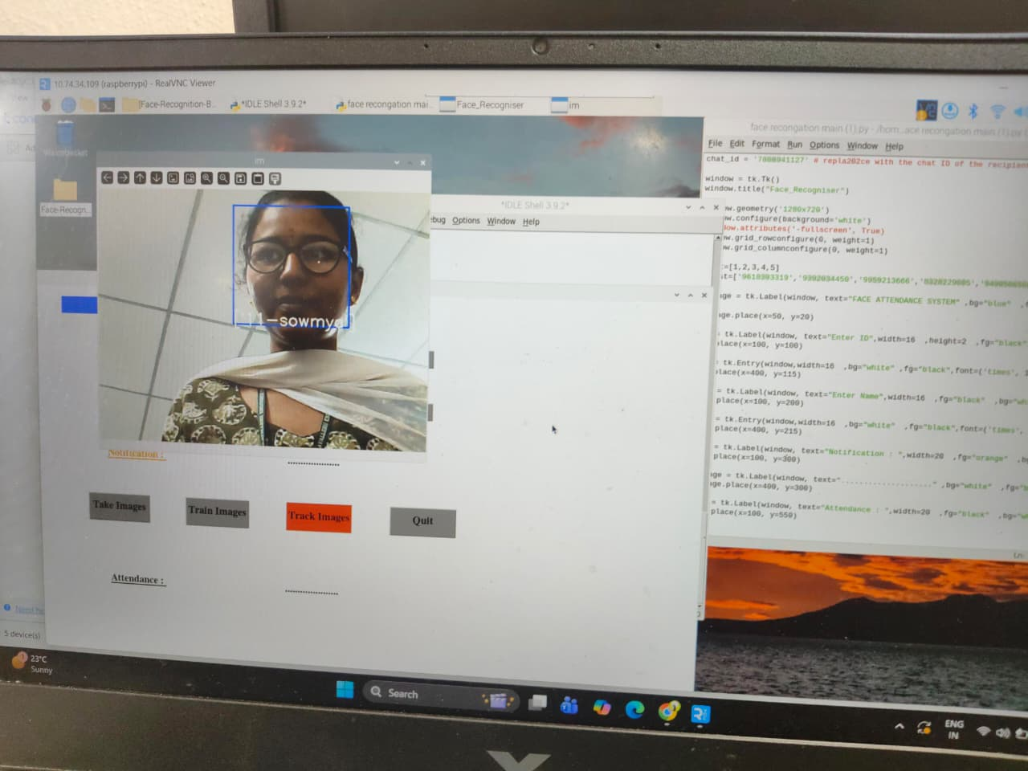
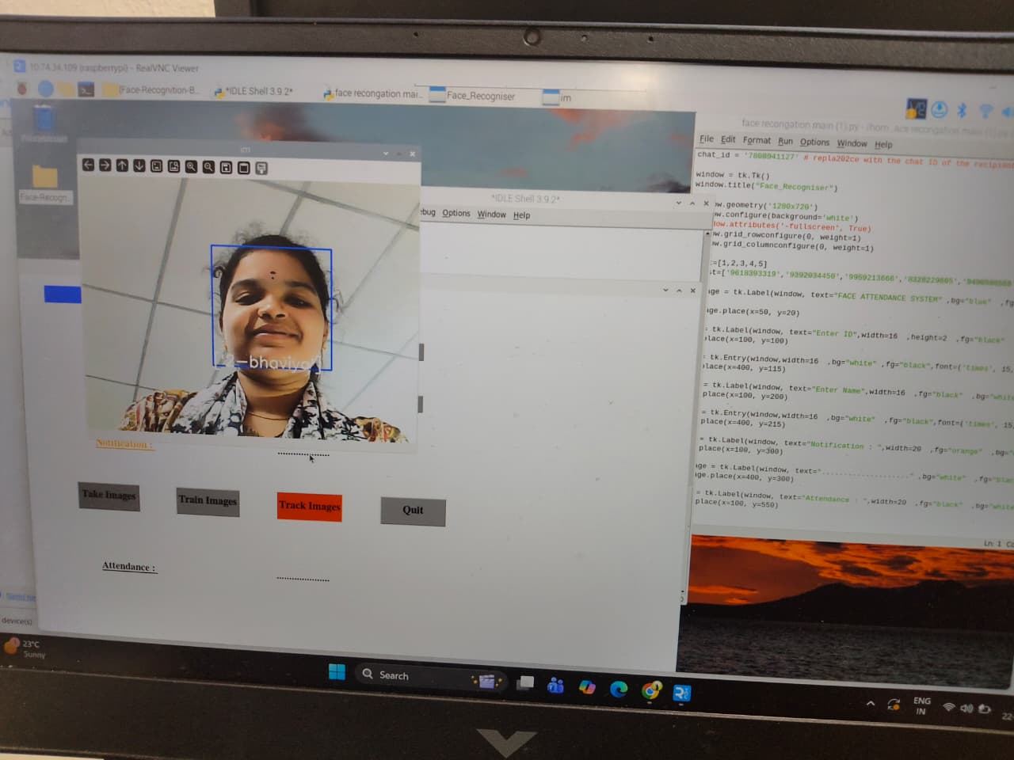
RESULTS
Registered & Recognized User 1
Registered & Recognized User 2
Date:25-02-2026
13

Slide 16
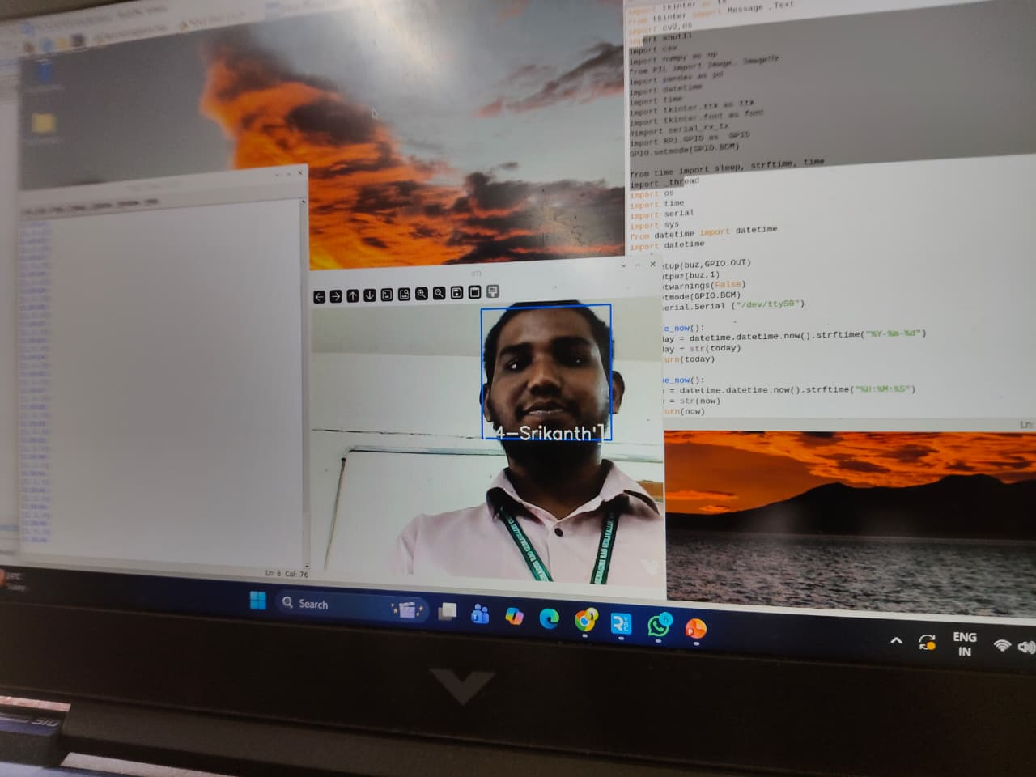
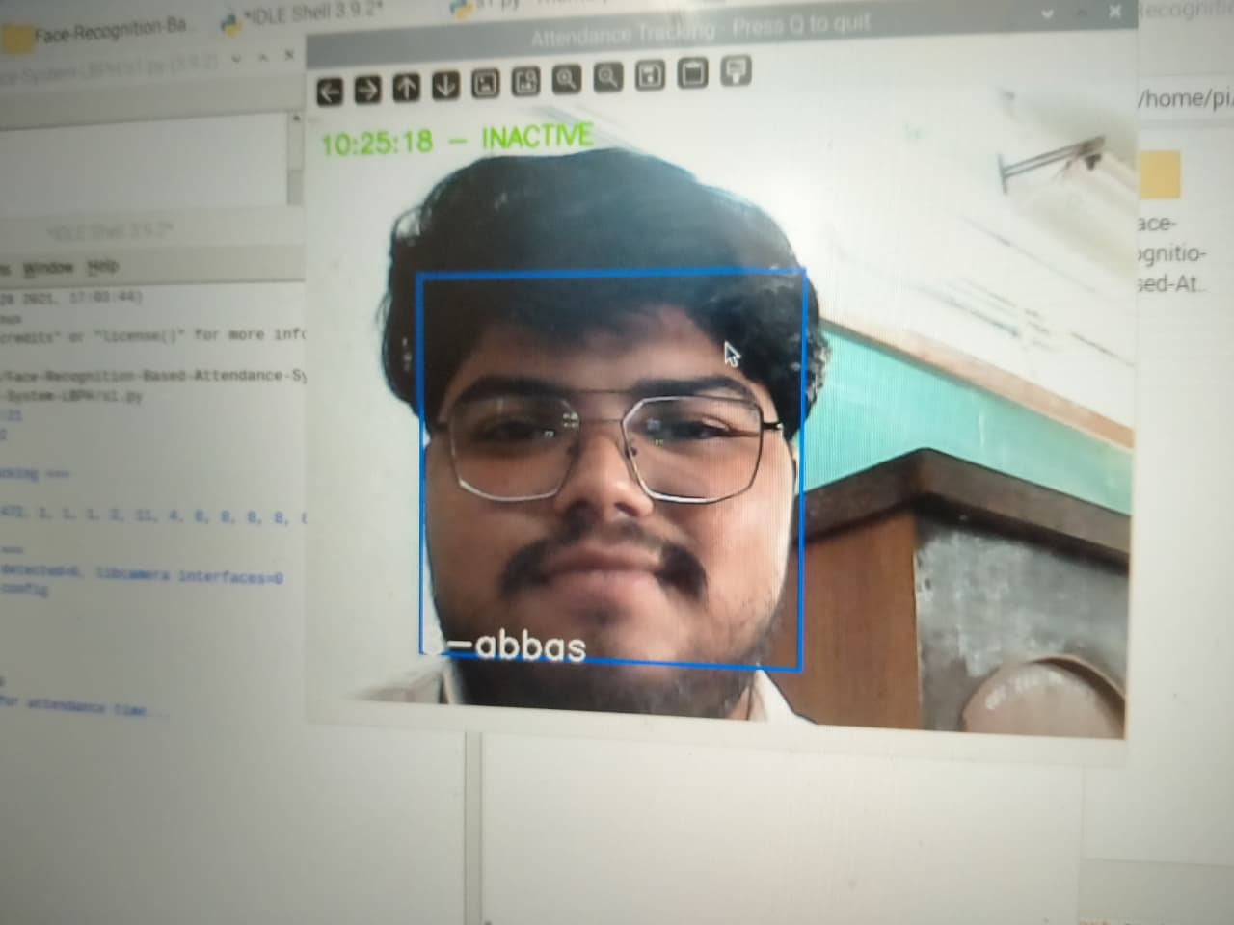
RESULTS
Registered & Recognized User 3
Registered & Recognized User 4
Date:25-02-2026
14

Slide 17
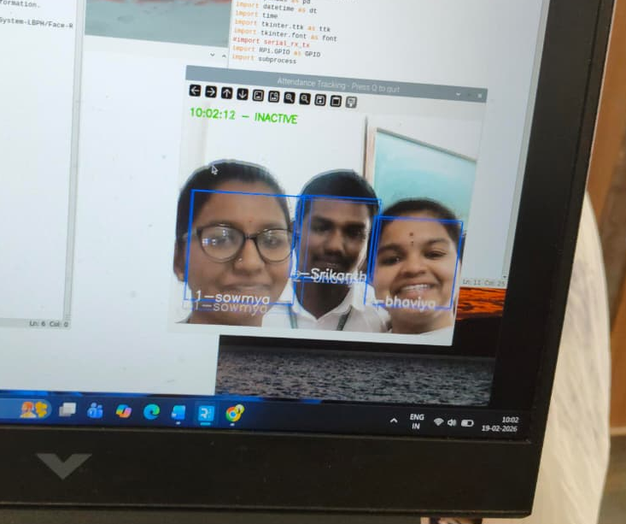
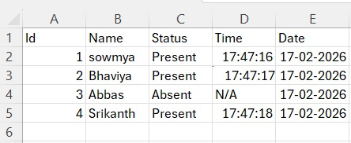
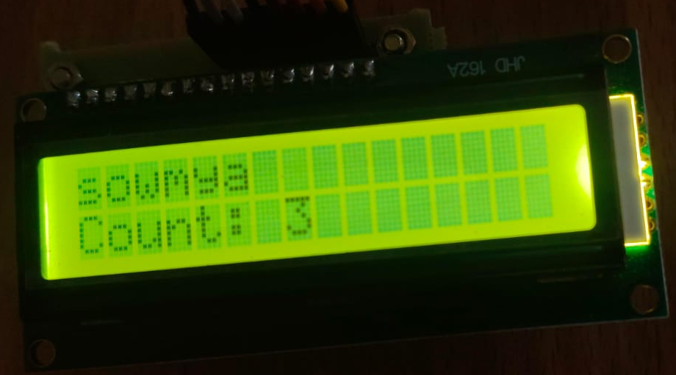
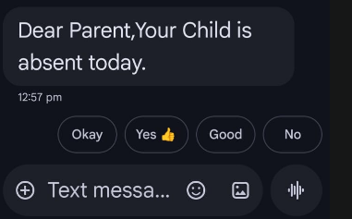
RESULTS
Fig. Real-Time Recognition of Multiple Registered Users in a Single Frame
Fig. Automated Attendance Log Stored in Excel Format
Fig. Real Time User Recognition and Head Count
Fig. Real-Time SMS Notification Sent to Parents
Date:25-02-2026
15

Slide 18
COMPARSION OF EXISTING AND PROPOSED SYSTEM
S.No. | EXISTING SYSTEM | PROPOSED SYSTEM
1. | Starts with scanning an RFID card. | Starts automatically with camera capturing student faces.
2. | Two-step verification - RFID UID check + face match | Single-step verification-face recognition only.
3. | Slower due to two-step process, especially in large classrooms. | Faster, can recognize multiple students in a single frame.
4. | RFID cards can be lost or misused. | No dependency on cards,reduces misuse.
5. | Attendance is recorded or rejected,no instant notifications. | Automatic attendance is recorded and parents are notified of absentees.
Date:25-02-2026
16

Slide 19
CONCLUSION
This project develops an IoT and ML-powered Smart Vision-Based Attendance System that provides an efficient and accurate way to manage attendance through real-time monitoring.
Overall, the project demonstrates how IoT and machine learning can enable smart, automated systems that enhance accuracy, security and operational efficiency.
Date:25-02-2026
17

Slide 20
REFERENCES
[1]N. Thaleeparambil, A. Biju, and B. Prathap, “Integrated Automated Attendance System with RFID, Wi-Fi, and Visual Recognition Technology for Enhanced Classroom Security and Precise Monitoring,” in Proc. IEEE InC4, 2024.
[2] D. V. Darshan, et al., “IoT-Based Attendance Monitoring with Facial Recognition,” in Proc. IEEE Int. Conf. on Advanced Information Technology (ICAIT), 2024.
[3] A. Raj, et al., “Facial Recognition-Based Student Attendance System,” in Proc. IEEE Int. Conf. on Recent Innovations in Technology and Optimization (ICRITO), 2024.
[4]G. Ramani, et al., “Smart Attendance System Using IoT,” in Proc. IEEE Int. Conf. on Communication and Computational Systems (ICCCS), 2023.
[5]N. Ramakrishnan, A. Ajil, A. Ali, A. Meenakshi Sundaram, and V. Sanju, “Wi-Fi Based Smart Attendance Monitoring System,” in Proc. IEEE CSITSS, 2023.
Date:25-02-2026
18

Slide 21
EXECUTION VIDEO LINK
https://drive.google.com/file/d/1IPEvl9DWOL4ycBJFg3MwOF5nne3dIawR/view?usp=sharing
The above link presents the project of Smart Vision Based Attendance System Using IoT and ML With Real Time Notifications
Date:25-02-2026
19

Slide 22
ANY QUERIES?

Slide 23
THANK YOU!

